Slide 1

Automatic Detection of Parkinson’s Disease Using Gait Signals and State Space Models/Mamba
Superviseded by:
Dr.-Ing. Tomás Arias-Vergara
Pattern Recognition Lab
Department of Computer Science
Friedrich-Alexander-Universität Erlangen-Nürnberg
Submitted by
Prosenjit Chowdhury
MSc Artificial Intelligence (23361276)
Pattern Recognition Lab
Department of Computer Science
Friedrich-Alexander-Universität Erlangen-Nürnberg

Slide 2
Agenda
Subheadline möglich. Gegebenenfalls löschen.
01
Motivation & Introduction
07
Results – Right, Left and Combined Foot Analysis
02
Dataset Description & Demographics
08
Observations & Discussion
03
Signal Examples (Healthy Control vs Patient)
09
Challenges and Limitations
04
Feature Extraction Process (TSFresh – 30 ms / 15 ms)
10
Future Directions (Mamba Model Integration)
05
Feature Aggregation & Statistical Summary
11
Conclusion
06
Dimensionality Reduction (PCA Analysis)
12
Q & A Session

Slide 3
Motivation & Background

Slide 4
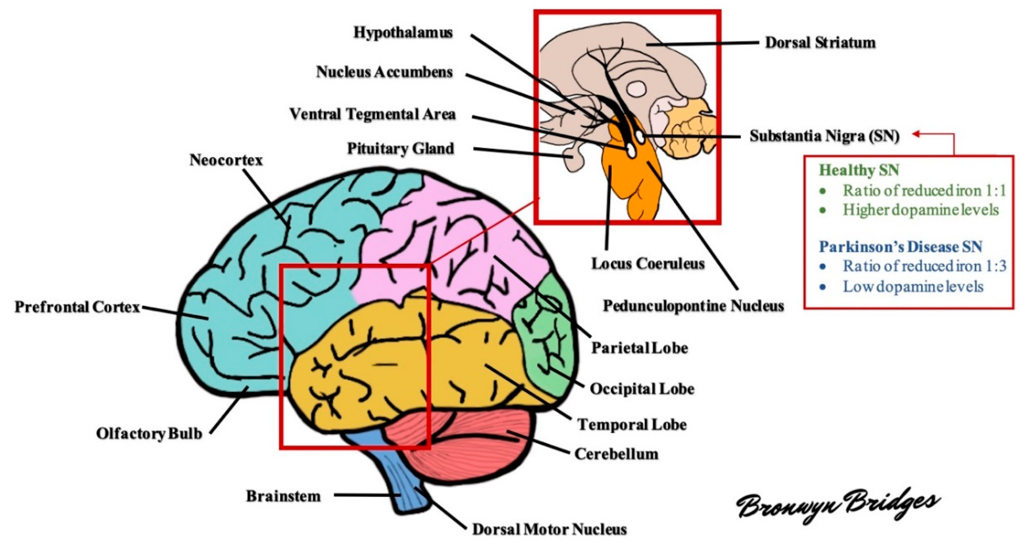
Motivation and Background
Image source: Bronwyn Bridges et al. (2020), Molecules, MDPI, https://doi.org/10.3390/molecules25194382
Parkinson’s Disease (PD) affects gait rhythm and symmetry.
Ground reaction forces (VGRF) from walking can capture these motor abnormalities.
Early gait-based detection enables timely clinical intervention.
This project establishes a feature-level baseline before applying Mamba/State Space Models.

Slide 5
Dataset Description & Demographics

Slide 6
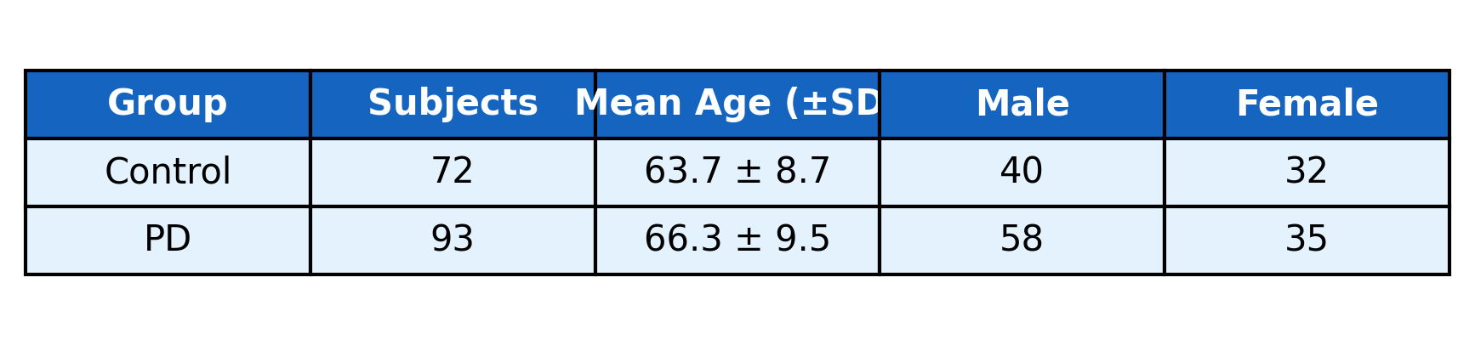
Dataset Overview-1
Figure: Participant demographics distribution by group, age, and gender.
Total of 165 subjects analyzed (72 Controls, 93 PD patients).
Mean age: PD group is slightly older (66.3 ± 9.5 years) than Controls (63.7 ± 8.7 years).
Gender balance: Both groups have comparable male, female ratios, ensuring unbiased comparisons.
Relevance: These demographic similarities support reliable baseline feature and gait analysis.

Slide 7
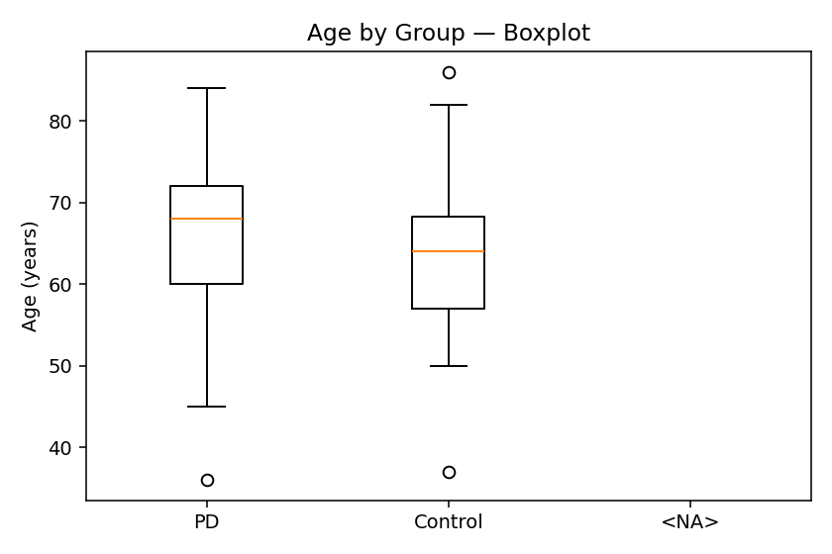
Dataset Overview-1
Figure: Age distribution by group
Dataset: 306 subjects (≈ 214 PD + 92 Controls
Signal type: Vertical Ground Reaction Force (VGRF) from both feet
Sampling rate: 100 Hz (10 ms intervals)
Observation: PD group shows higher median age, but similar variability
Relevance: Ensures demographic comparability before model training

Slide 8
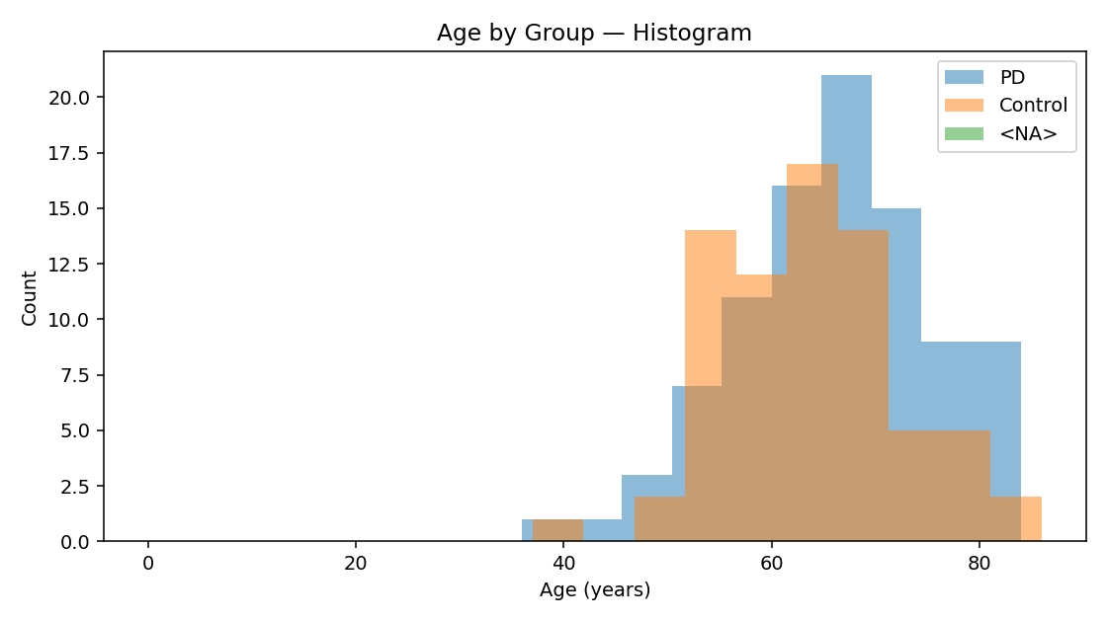
Dataset Overview-2
Figure: Age distribution histogram
Visualizes age distribution across PD and Control subjects.
PD participants show a higher frequency in the 65–80 year range.
Both groups have comparable spread, supporting balanced dataset demographics.

Slide 9
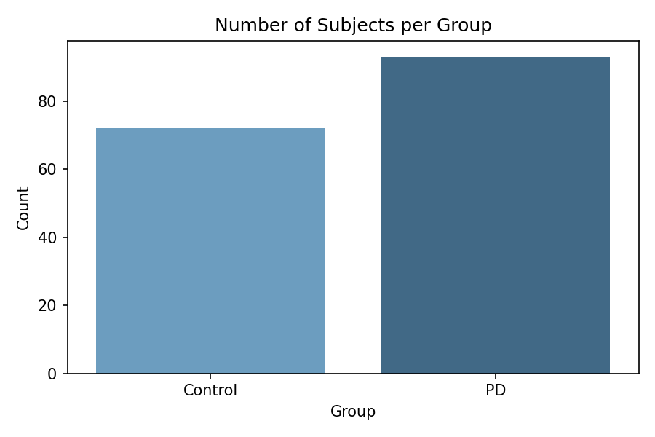
Dataset Overview-3
Figure: Subject distribution across PD and Control groups
Visualizes participant count per group.
~70 Control and ~90 PD subjects included in analysis.
Slightly higher PD count, ensuring adequate representation for both classes.
Balanced group size supports fair model training and comparison.

Slide 10
Example Signals

Slide 11
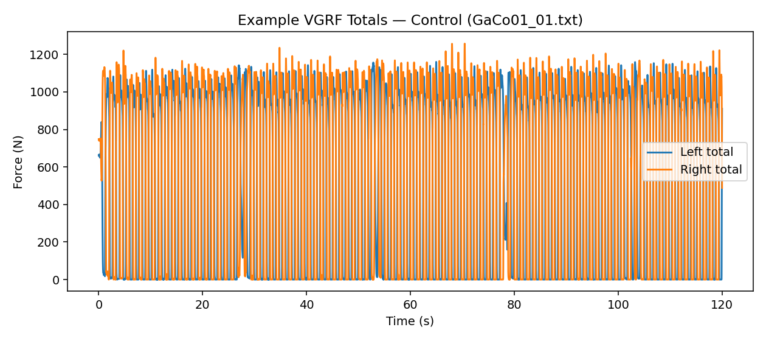
Example VGRF Signals-1
Dataset collected using force plates measuring Vertical Ground Reaction Force (VGRF) at 100 Hz sampling rate.
Figure: Control subject VGRF pattern
Shows periodic Vertical Ground Reaction Force (VGRF) signals for a healthy control.
Left and right foot curves overlap closely, indicating rhythmic and stable gait.
Demonstrates the normal force distribution pattern used as baseline for PD comparison.
Dataset collected using force plates measuring Vertical Ground Reaction Force (VGRF) at 100 Hz sampling rate.
Each subject walks over the plate; sensors record force (N) exerted by the left and right foot.
Force curves capture gait rhythm, symmetry, and balance — which differ between (PD) and Control groups.
Example signals show reduced amplitude and irregular rhythm for PD.

Slide 12
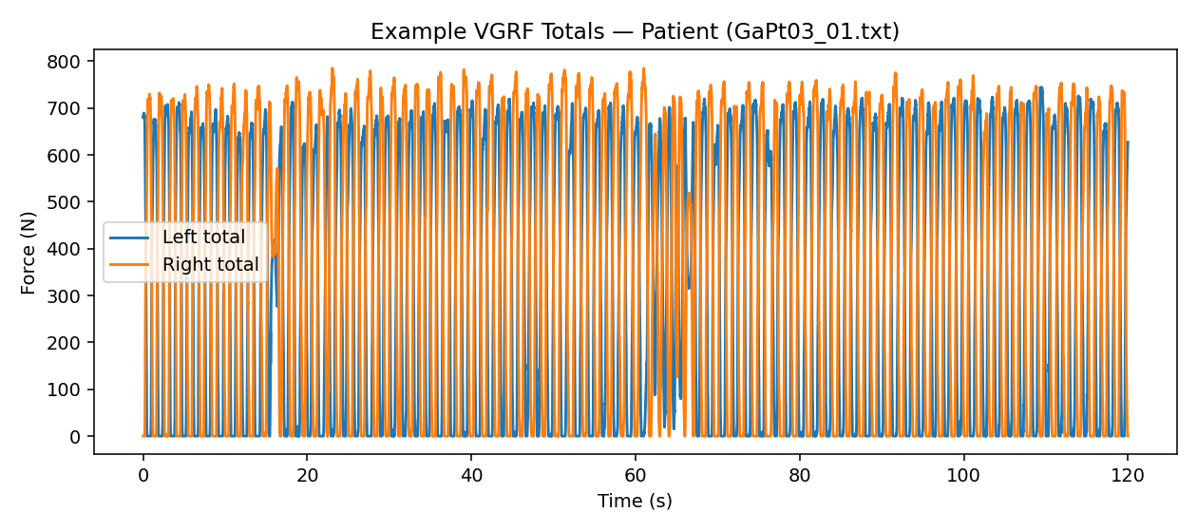
Example VGRF Signals-2
Figure: PD subject VGRF pattern
Displays Vertical Ground Reaction Force (VGRF) for a Parkinson’s patient.
Left and right foot signals show irregular amplitude and timing differences.
Indicates gait asymmetry and instability, typical of PD-related motor impairment.

Slide 13
Feature Extraction Approach

Slide 14

Feature Extraction with TSFresh
Figure: TSFresh-based feature extraction workflow
Image source: Bronwyn Bridges et al. (2020), Molecules, MDPI, https://doi.org/10.3390/molecules25194382
Raw VGRF time series are transformed into statistical features using TSFresh.
Features summarize time-domain properties: → mean, standard deviation, skewness, kurtosis, energy, RMS, zero-crossings, etc..
Extraction performed using a 30 ms window with 15 ms overlap.
Each feature represents a short segment of the gait signal.
Result: ~56 features per subject per foot after aggregation.

Slide 15
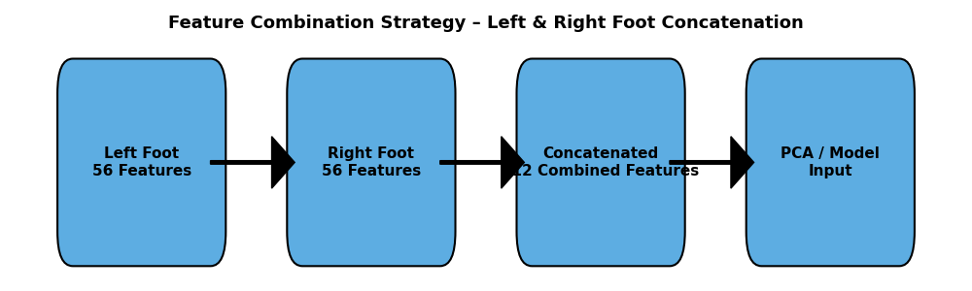
Feature Combination Strategy
Figure: Feature Combination Strategy
Each subject has two independent feature sets: → Left foot features (56 columns) → Right foot features (56 columns)
To analyze inter-foot coordination: → Concatenated horizontally → 112 combined features (LR vector).
Two approaches tested:
Concatenation: merge L + R feature vectors.
Averaging: compute mean of corresponding left/right features.
Combined feature set improves PD detection by capturing gait asymmetry.

Slide 16
Feature Analysis (Variance & Correlation)

Slide 17
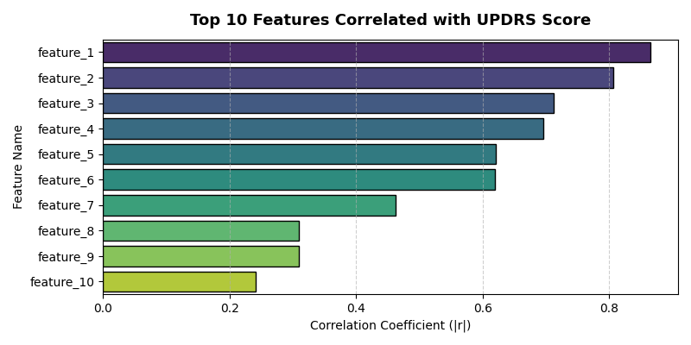
Feature–UPDRS Correlation Analysis
Figure: Feature–UPDRS Correlation Analysis
Correlation computed between each extracted feature and UPDRS score.
High correlation indicates stronger predictive power for disease stage.
UPDRS (Unified Parkinson’s Disease Rating Scale) measures PD severity (higher = worse).
Visualization methods: → Heatmap of feature–UPDRS correlation. → Bar plot of top correlated features.
Helps identify the most informative gait parameters (e.g., variability, symmetry).

Slide 18
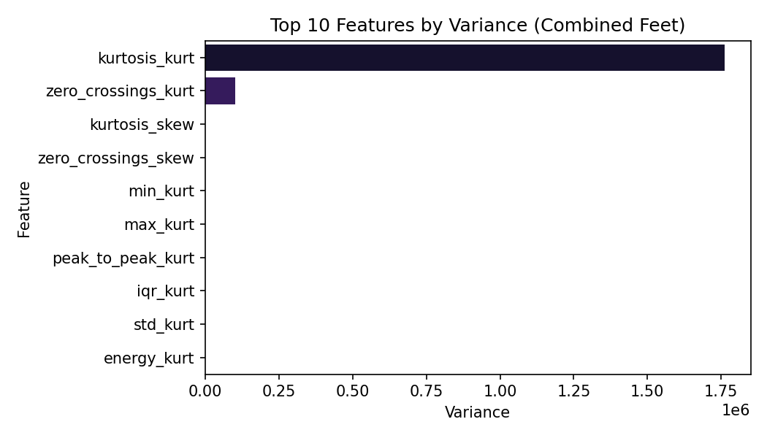
Feature Variance and Correlation Analysis-1
Figure: Top 10 high-variance features (combined feet)
Displays the most variable TSFresh features from combined left–right foot data.
Kurtosis_kurt shows the largest variance, suggesting strong sensitivity to gait irregularities.
Variance ranking helps identify the most discriminative features for PD vs. Control.
These top features are later used for dimensionality reduction via PCA.

Slide 19
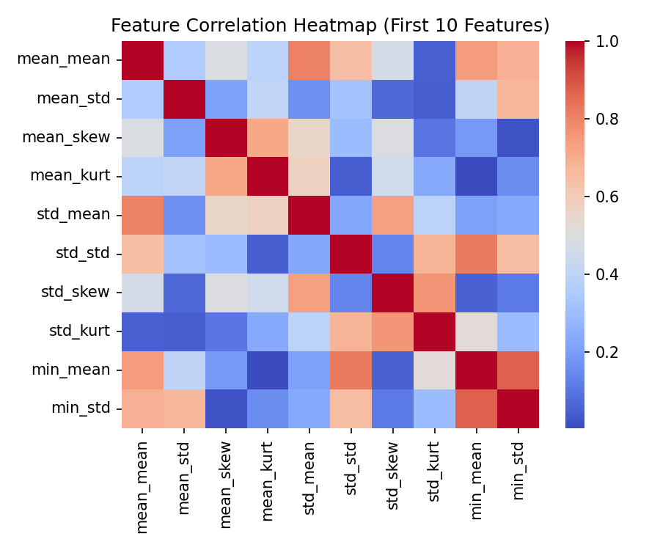
Feature Variance and Correlation Analysis-2
Figure: Correlation among top 10 features
Displays correlation between the first 10 extracted TSFresh features.
Moderate correlations observed between mean and standard deviation metrics.
High feature redundancy is visible, justifying the use of PCA for dimensionality reduction.
Ensures that strongly correlated features are compactly represented for efficient analysis.

Slide 20
Bilateral Feature Distribution

Slide 21
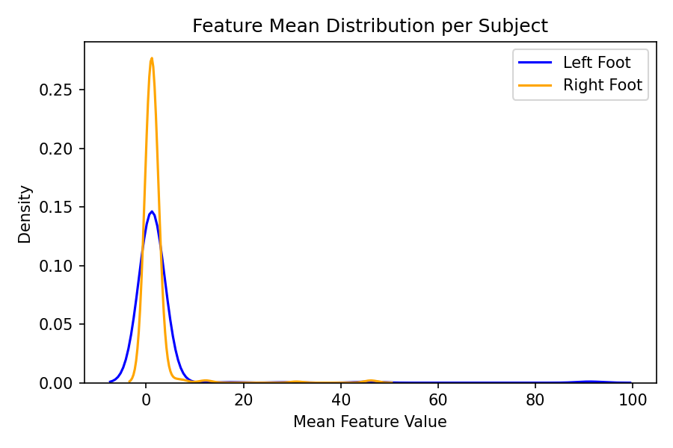
Left vs Right Foot Feature Distribution
Feature mean distribution across left and right feet
Compares mean feature distributions between left and right foot signals.
Both feet show a similar overall distribution, confirming consistent gait capture.
Slight right-foot dominance may indicate asymmetric force behavior in PD patients.
Confirms that extracted features are balanced across sides before PCA analysis.

Slide 22
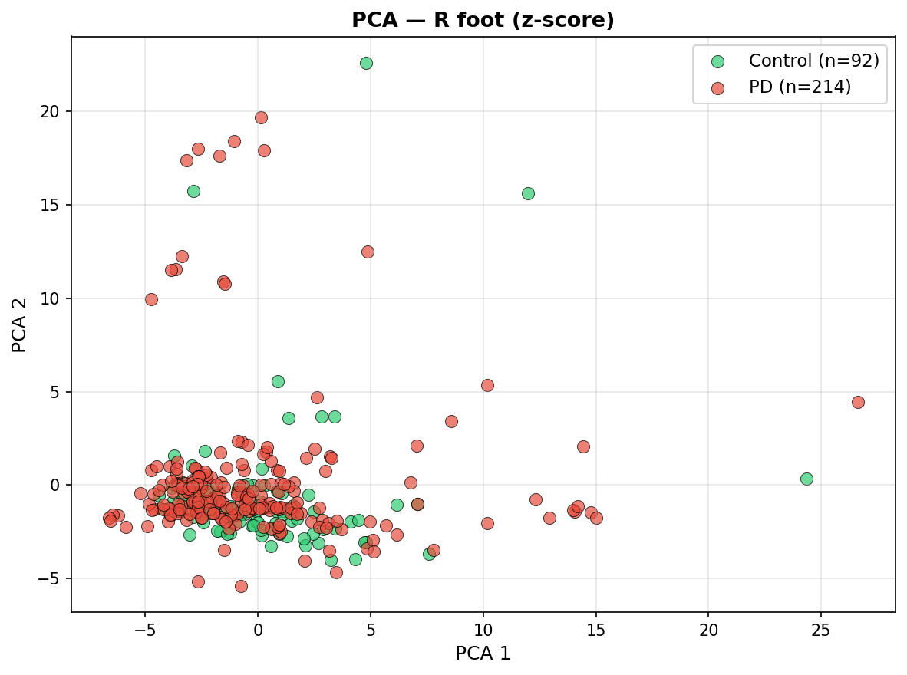
Dimensionality Reduction (Right Foot)
PCA Visualization – Right Foot Features
Figure: PCA projection for right-foot features
PCA reduced 56-dimensional right-foot features to 2 principal components.
Partial class separation is observed between PD (red) and Control (green) subjects.
The right-foot dynamics reveal stronger gait irregularities in PD participants.
Highlights that right-foot features may be more sensitive indicators of motor asymmetry.

Slide 23
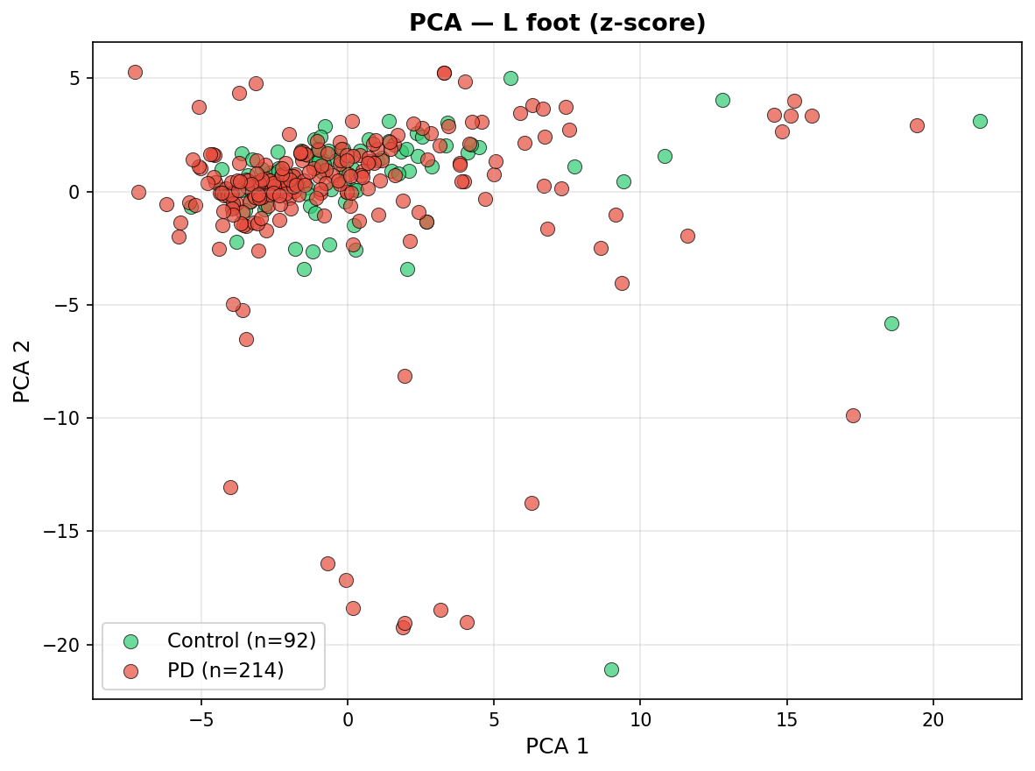
Dimensionality Reduction (Left Foot)
PCA Visualization – Left Foot Features
Figure: PCA projection for left-foot features
PCA reduced 56 left-foot features to 2 principal components for visualization.
Control (green) and PD (red) subjects show overlapping clusters with mild separation.
Left-foot data appears slightly more compact, indicating consistent stride rhythm.
Suggests that PD-related asymmetry is less pronounced on the left side compared to the right.

Slide 24
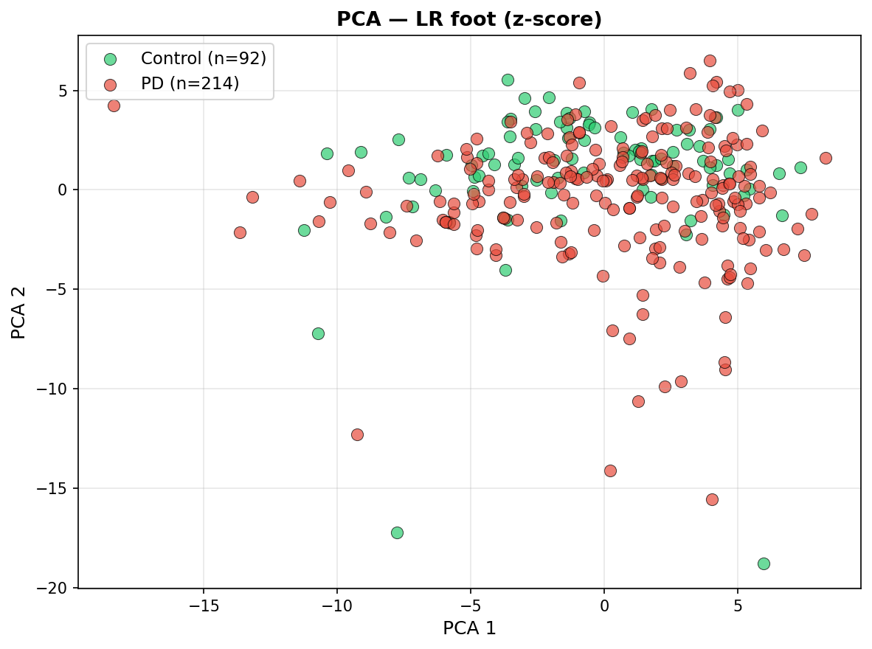
Dimensionality Reduction (Combined Feet)
PCA Visualization – Combined Left & Right Features
Figure: PCA projection for combined left & right foot features
Combines left and right foot features to analyze overall gait symmetry.
PCA reveals partially separable clusters between PD and Control participants.
Integration of both feet provides richer movement representation and balance cues.
This combined feature space will guide future Mamba-based classification modeling.

Slide 25
Results Summary

Slide 26
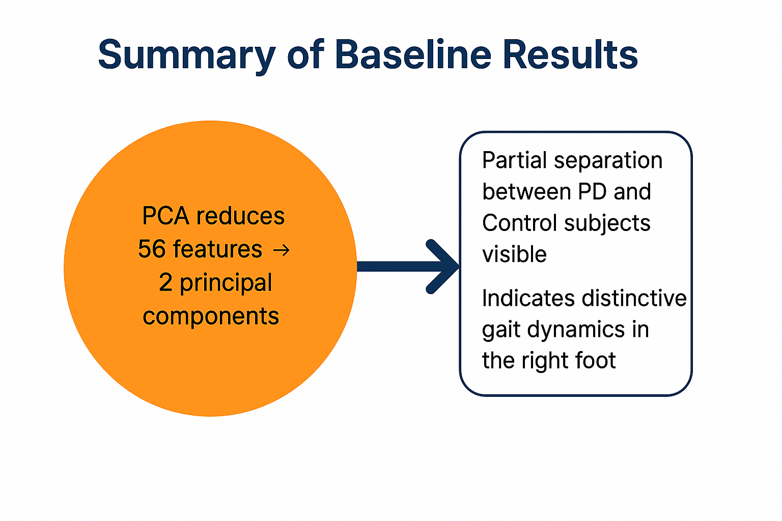
Summary of Baseline Results
306 subjects analyzed (≈ 214 PD + 92 Controls).
Extracted 56 TSFresh features per subject using 30 ms windows with 15 ms steps.
Applied Z-score normalization followed by PCA for dimensionality reduction.
PCA revealed partial separation between PD and Control groups, indicating feature sensitivity to gait asymmetry.
Right foot features showed stronger differentiation patterns, suggesting higher diagnostic relevance.
These results establish a reliable feature-level baseline for upcoming Mamba/State Space Model integration.

Slide 27
Discussion & Next Steps

Slide 28
Discussion & Future Direction
The PCA results indicate partial separability between PD and Control subjects, confirming the discriminative potential of extracted gait features.
Variability within PD samples suggests heterogeneous motor impairment patterns, aligning with clinical findings.
The baseline feature analysis successfully demonstrates measurable differences in gait dynamics, validating the preprocessing and feature engineering pipeline.
Future work will focus on implementing State Space Models (SSM) and Mamba architectures to capture temporal dependencies in gait signals.
These models aim to enhance classification accuracy and provide interpretable, real-time Parkinson’s detection capabilities.

Slide 29
Q & A

Slide 30
Thank you

